Slide 1
Automatic Posing of a Meshed Human Model Using Point Clouds
Lei Wang
Joint work with Tamal K. Dey,
Huamin Wang and Bo Fu
Notes:
Our accepted paper is “automatic posing of a meshed human model using point clouds”. Bo Fu is from uky.

Slide 2
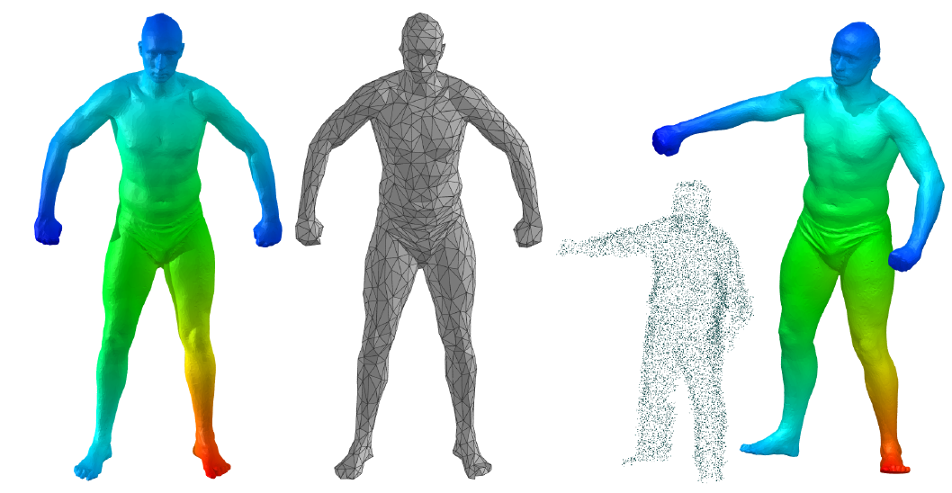
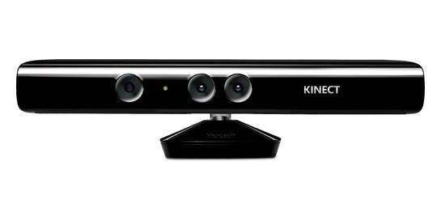
Problem Statement
Low-end scanning devices are becoming popular. But quality of their output…
Reconstruct from problematic human scans by deforming a prior high quality template mesh
Notes:
In the past, 3D scanner market was dominated by professional devices. They are expensive, may cost tens of thousand of dollars. And may hard to operate, some require controlled light environment.
As the technique evolves, cheap, low-end scanning devices such as Kinect are becoming affordable and popular. They are easy to use. But quality is not satisfying. Noise and occlusion are common for the output. While there exist reconstruction methods dealing with noise and undersampled area. Details may lost. Holes may be filled with artifacts.
But for consumer level devices, one important application is entertainment, and scanned objects are usually humans. So we focus on reconstructing humans. To achieve that goal, we exploit the flexibility of human bodies to achieve our goal. Our method uses a high quality template mesh, and accepts a point cloud as input. Then it generates the output which matches the pose and shape of the input point cloud by deforming the template mesh.

Slide 3
Related Work
Model-based Registration
Parametric human body models
Registration without a Model
Manual intervention
Non-rigid registration by nonlinear optimization
Isometric deformations: keep geodesic distance unchanged
Notes:
Parametric human body models require a database of human shapes and bodies, as while as intensive computation
Non-rigid registration may not handle large deformation
Isometric deformations. Sounds reasonable. However, different people have different shapes, which means geodesic distance may be distorted. May need precise correspondence which is hard to get with noise and occlusion.

Slide 4
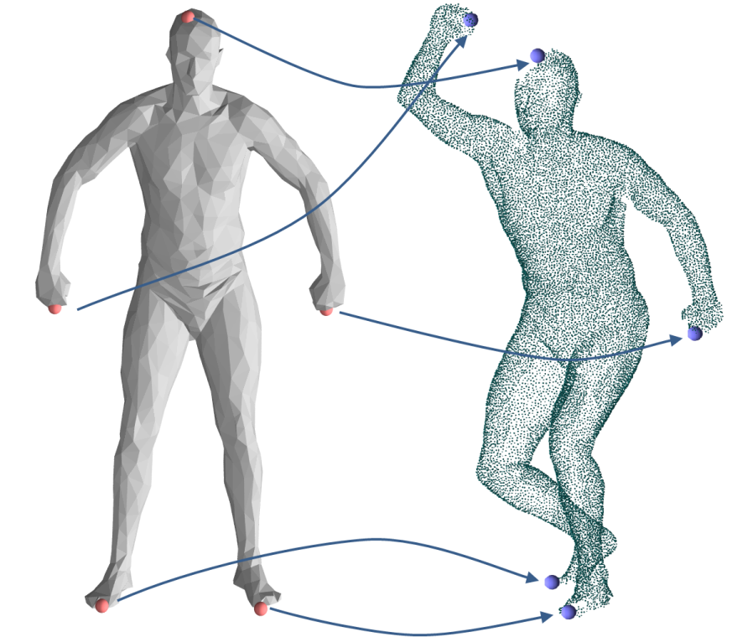
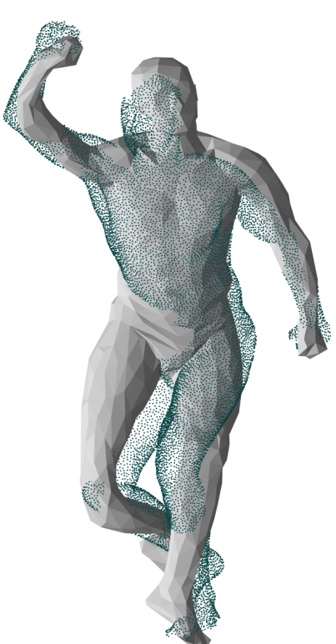
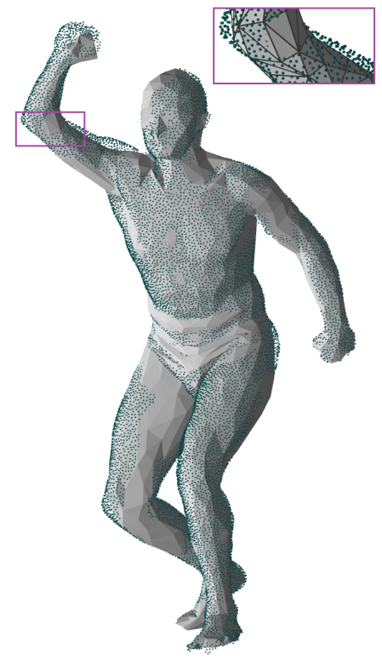
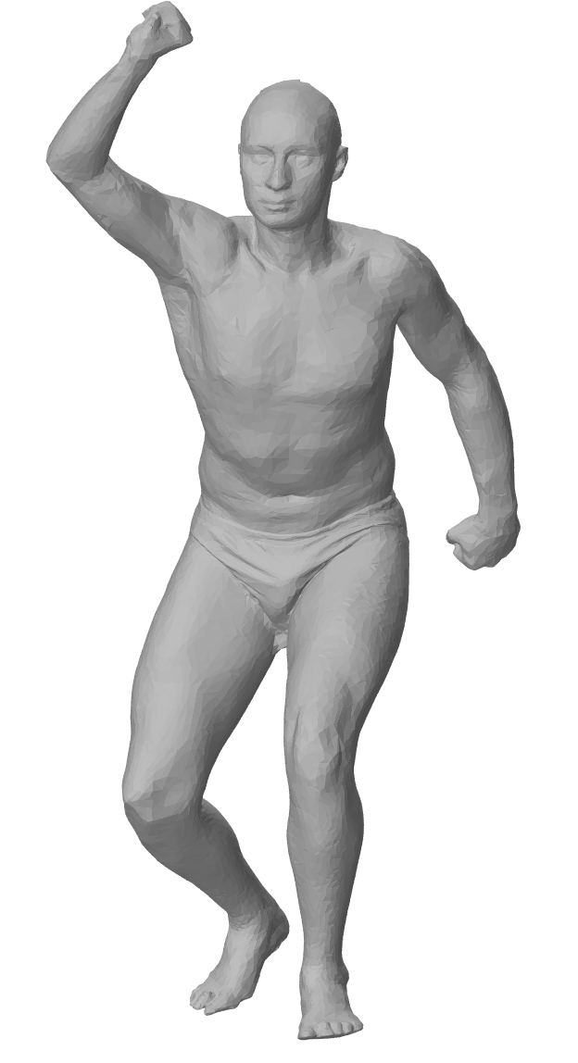
Our Method: Outline
computing correspondences
posing
output
Notes:
Generally, our method has two stages: computing correspondences between the template and the input scanning. And pose the template by the correspondences. Correspondence is used to guide the posing process, so we know head of the template goes to head of the scanned pose, left hand goes to let hand… To accelerate the deforming process, the deforming is applied on a simplified mesh contains 1K triangles. The deformed template is restored from the simplified mesh.

Slide 5
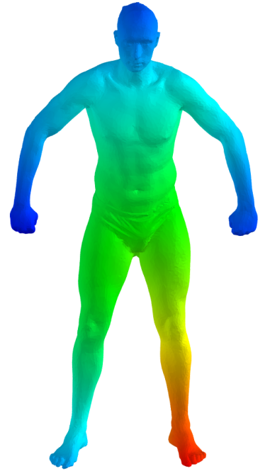
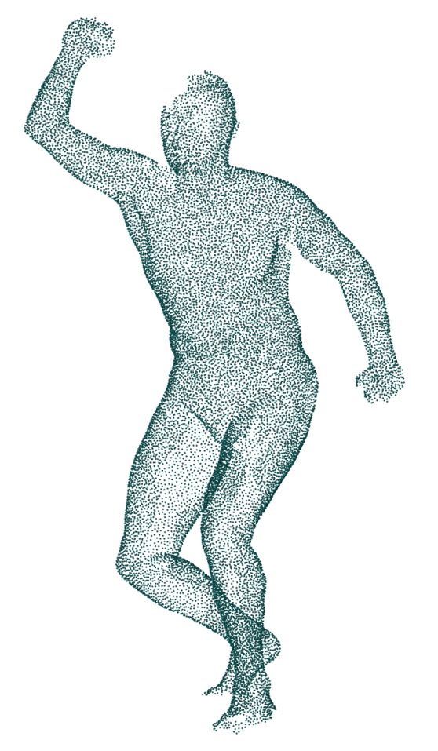
Computing Correspondences
Notes:
So the first problem we face is how to find correspondence between the template and the point cloud.

Slide 6
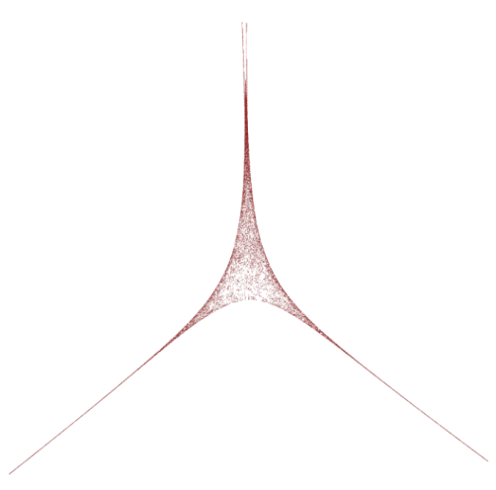
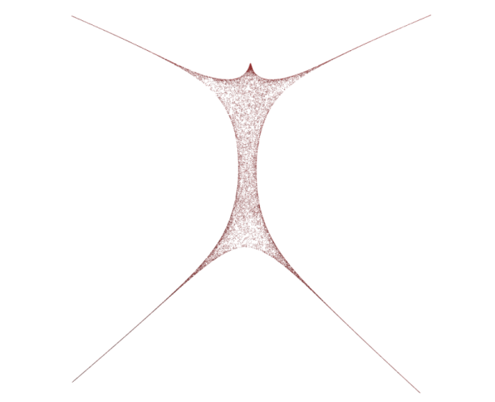
Computing Correspondences
The Global Point Signature (GPS) framework by [Rustamov 2007]:
Apply Gaussian-weighted Graph Laplacian on the adjacency graph of input point cloud
Graph Laplacian
GPS in dimension 1, 2 and 3
Notes:
We choose the GPS framework by Rustamov to find the correspondence between the template and the input scanning. For a point cloud, and a sampled point p in the cloud, GPS embeds p into the eigenspace represented by eigenvectors and eigenvalues, with dimension up to the number of points in the cloud. Here, phii(p) is the value of the eigenfunction phii at the point p. For our case, eigenvectors and eigenvalues are obtained by applying Gaussian-weighted Graph Laplacian on the adjacency graph of input point cloud. This image illustrates GPS of the template with one eigenfunction GPS, two eigenfunction GPS and three eigenfunction GPS.

Slide 7
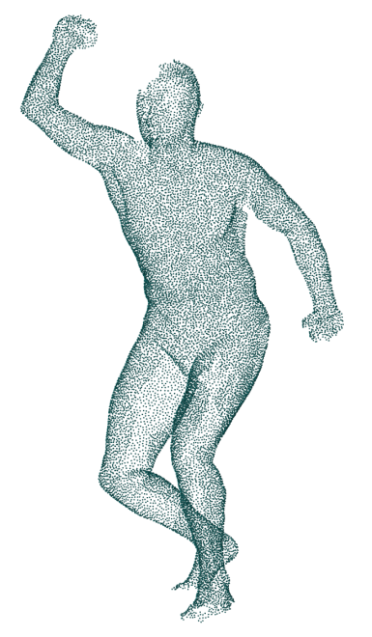
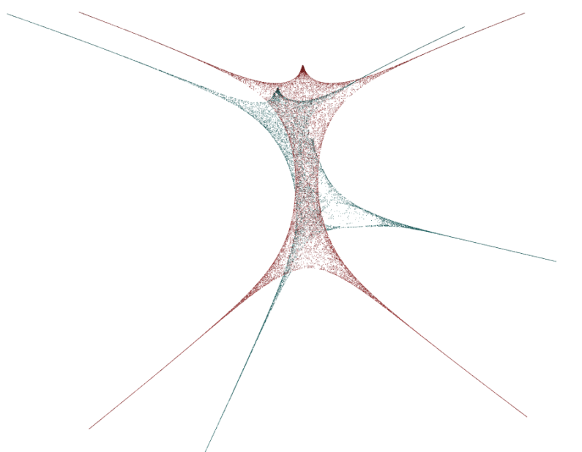
Computing Correspondences
GPS is invariant under isometric deformation
We choose only the first three eigenfunctions
Notes:
One important property of GPS is that the embedding is an isometry invariant (In mathematics, an isometry is a distance-preserving map between metric spaces.). In other words, it preserves geodesic distance. No matter how an object deforms, as long as the deformation keeps the geodesic distance, its GPS should be comparable. We know that no matter how we pose, the geodesic distance between two points on our body is almost the same. Thus GPS embedding is a powerful tool to provide correspondence between human shapes. As this image shows, GPS embedding of those two shapes can match after simple transformation.

Slide 8
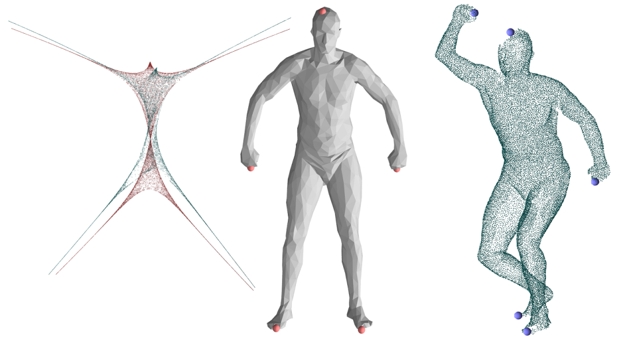
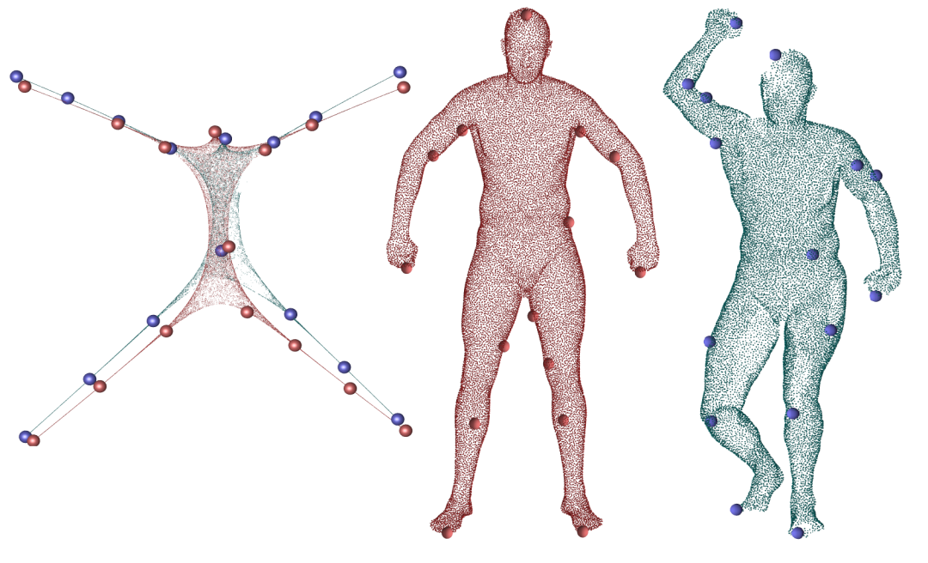
Computing Correspondences
Correspondences are expanded from 5 extremums of aligned GPS embeddings
Notes:
We first align the two GPS embeddings and find the five extreme points which are end points of head, hands and legs. Then we expand the correspondence to 60 pairs of points with good separation in the eigenspace.

Slide 9
Posing Template Mesh
Formulated as an energy minimization problem:
is the internal energy of template mesh
measures difference between template and the point cloud
Solved by Invertible FEM [Irving et al. 2004]
Notes:
With the found correspondence, we formulate posing process as an energy minimization problem. Here, Eelastic is the internal elastic energy of the template, and Ealign is the alignment energy that measures the distancen between the template and input scanning. We solve this energy minimization problem by physically based simulation. There are two forces, elastic force and alignment force. To make the simulation fast, we apply the posing process on a simplified volume mesh of the template. For poses with large deformation, inverted terahedra can be common, especially in joints. We use the invertible FEM to compute elastic forces for tets and handle inverted elements.

Slide 10
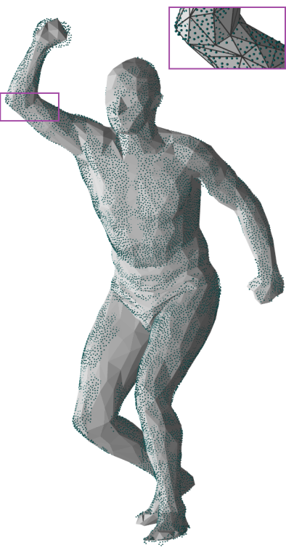
Posing Template Mesh
It has two stages
Initial alignment:
deformed by correspondence
Point cloud alignment: deformed by input point cloud
Notes:
Posing has two stages, elastic force is computed in the same way in both stages, but alignment force is computed differently during the posing process. The initial alignment stage reduces distance between corresponding points. Intuitively, it takes the alignment force as spring force between matched points. The left image shows results of initial alignment. The second stage is point cloud alignment, which minimizes Hausdorff distance from the point cloud to the template. The right hand image shows result after point cloud alignment.

Slide 11
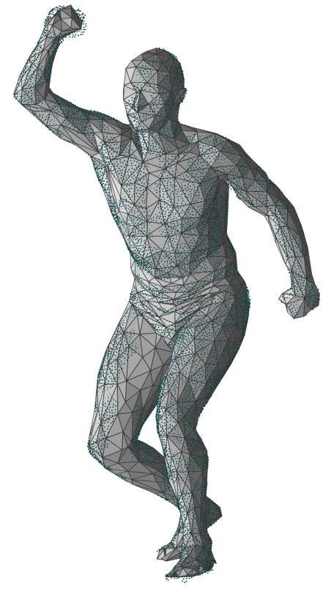
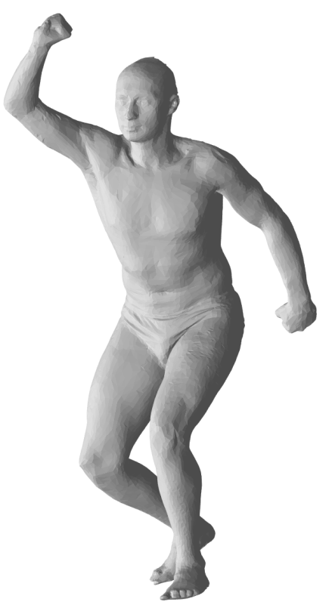
Posing Template Mesh
For efficiency, posing is performed on a simplified template mesh, called control mesh
Deformed template is recovered by Mean Value Coordinates [Ju et al. 2005], i.e., weighted sum of the control mesh
Notes:
Control mesh is converted to a volume mesh, which is required by invertible FEM. Note, the weight can be precomputed to save time

Slide 12
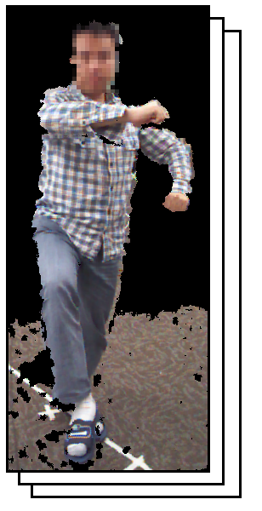
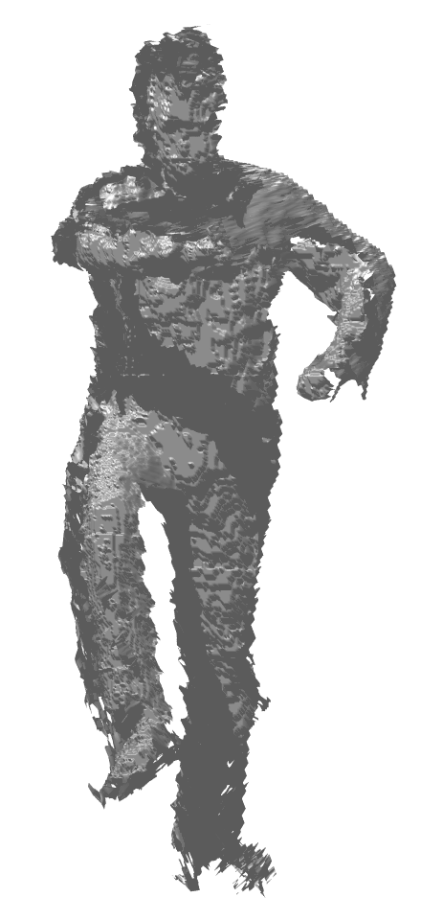
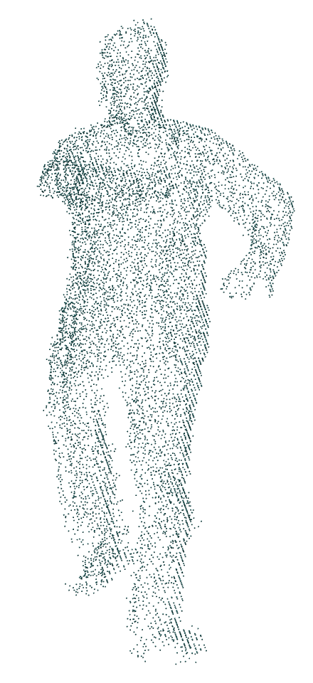
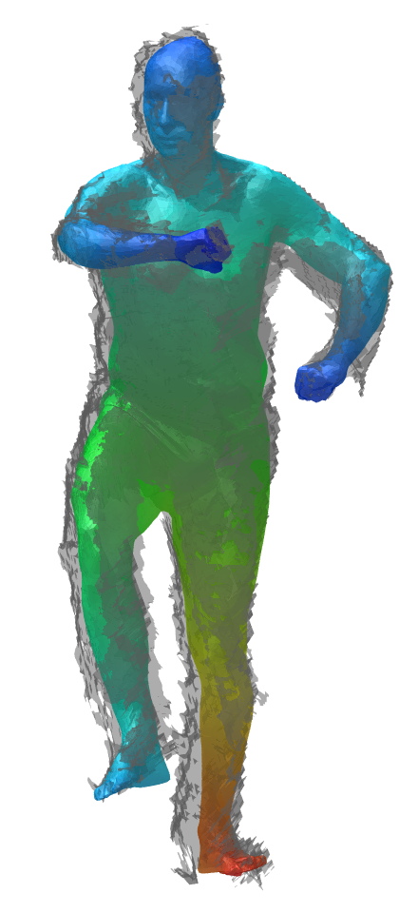
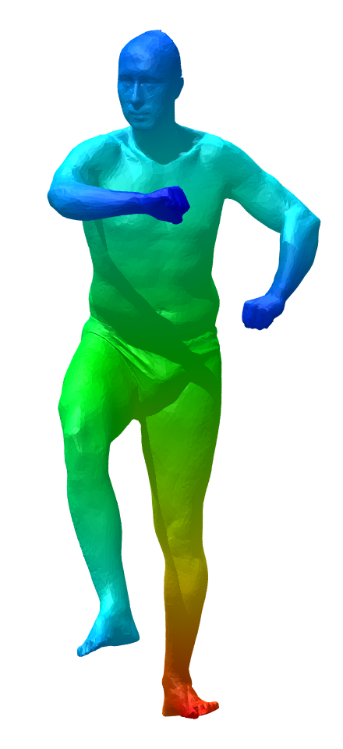
Results
Notes:
Here comes the experimental results. We tried data sets from various sources. The first one shows data collected by three Kinect sensors. They are placed with 120 degree separation. We can see that the output of Kinect is really noisy. And there are misalignment and occlusion. In the third image, we downsampled the Kinect output to point cloud with 20K points, and applied our method. The fourth images shows the deformed template overlapped with the input. And the last image shows the output.

Slide 13
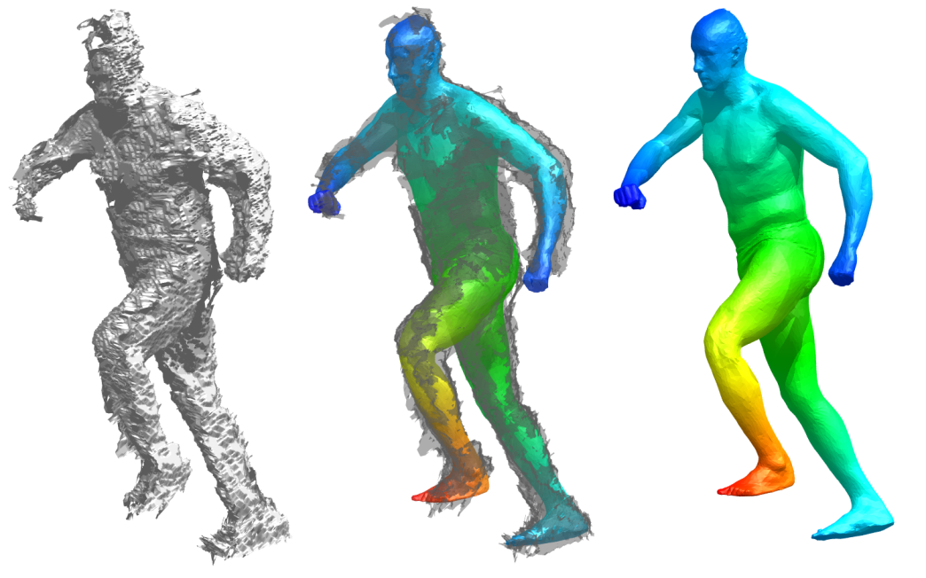
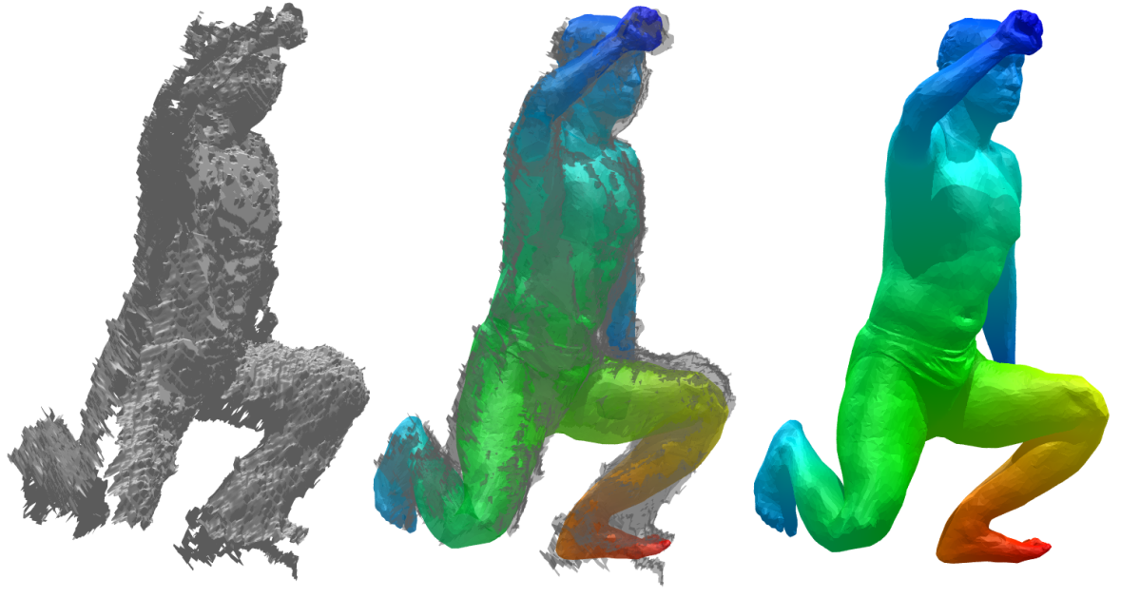
Results
Notes:
Here are more results with different poses. The top one is walking. The bottom one is crouching. Notice that for the crouching case, there is a large gap between two views. And the right knee is missing.

Slide 14
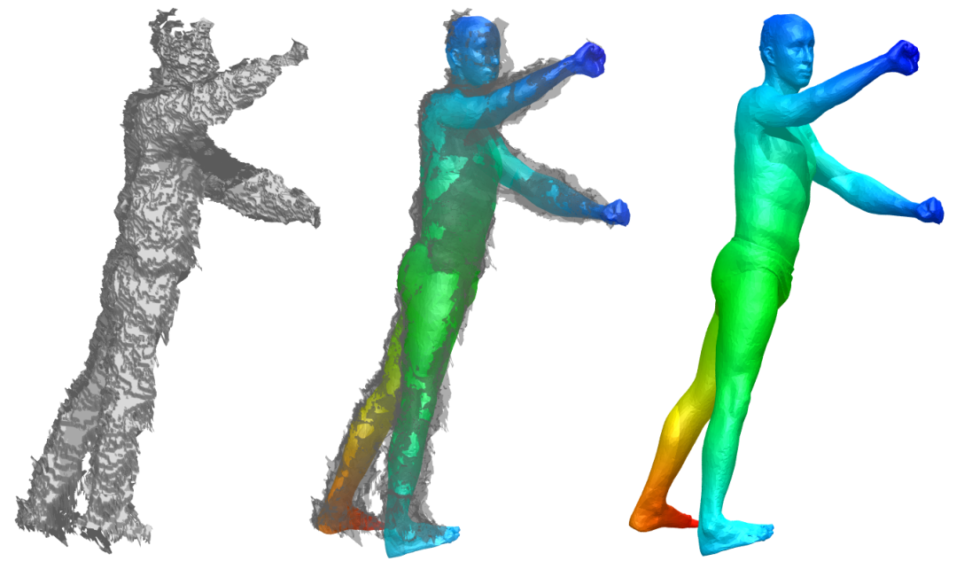
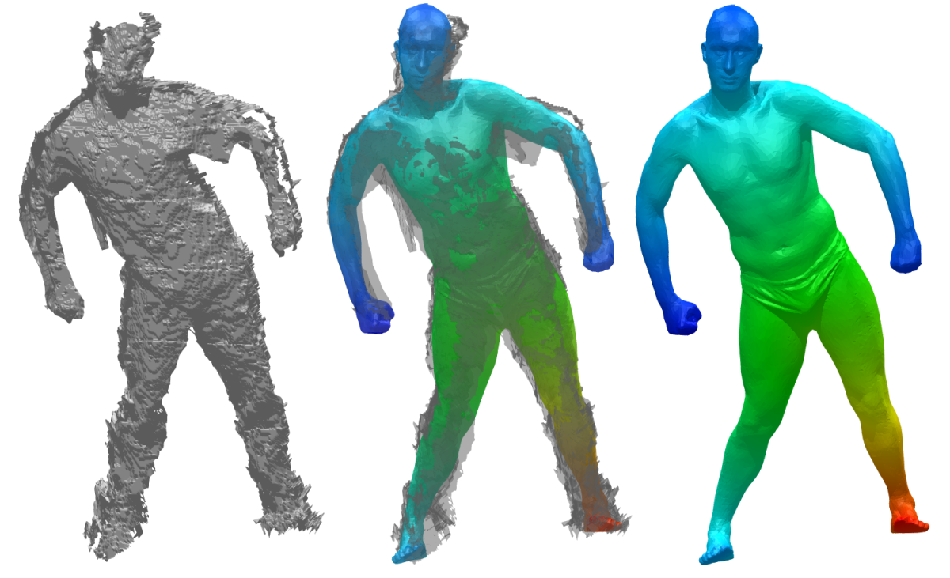
Results
Notes:
Two more poses. Different from many other methods, we do not require the subject to be naked. We can see the top pose wears a loose jacket or shirt and the other pose wears a T-shirt.

Slide 15
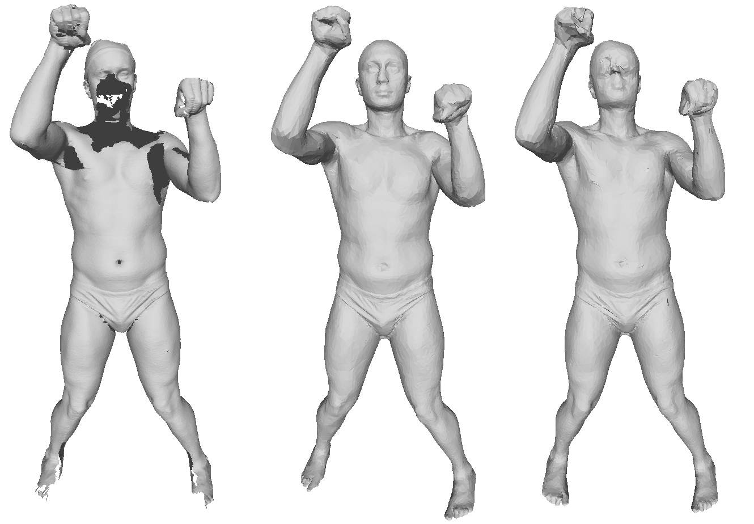
Results
(a) input scan (b) our method (c) SCAPE
Notes:
We also compared our result with other methods. For example, we compared with the result of SCAPE. We can see SCAPE failed on the face. That is an important place with lots of features.

Slide 16
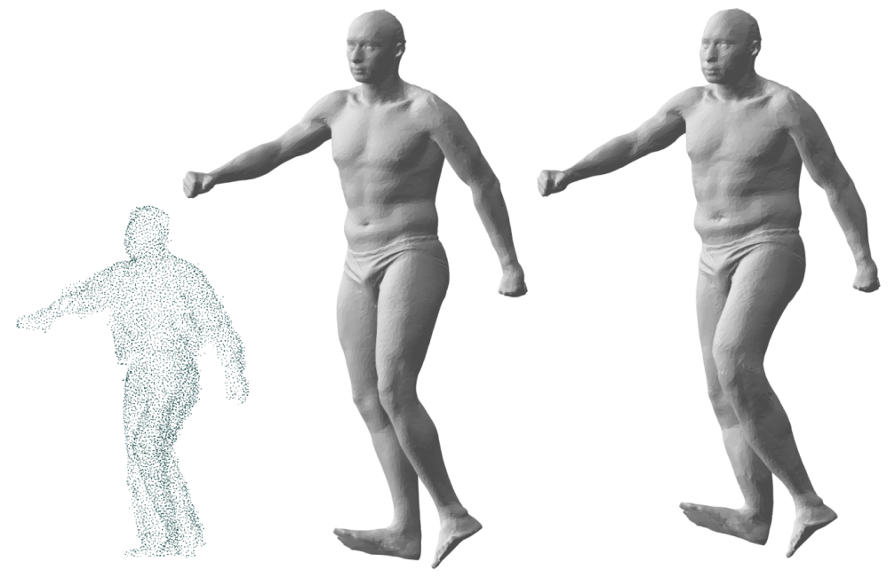
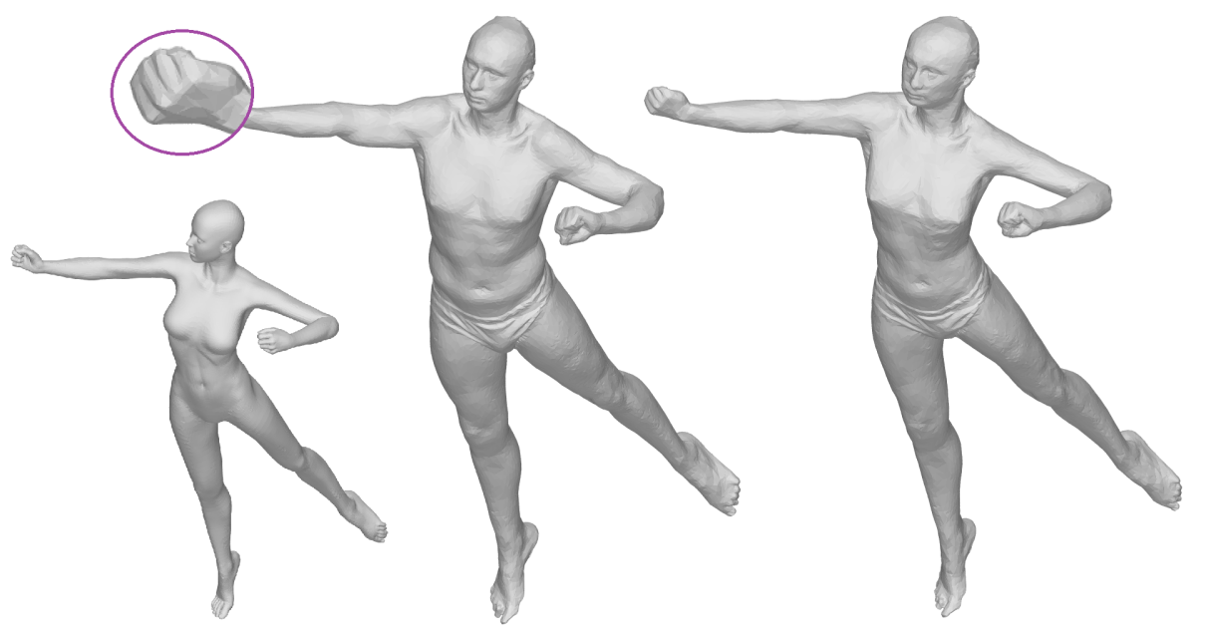
Results
can be used to control the body size
Notes:
An important role of Eelastic is to fit the template with the input. By change the weight of Eelastic, we can see the template not only posed by the point cloud, but also fit with the shape. One problem of our method, as highlighted here, is that hands or head may rotated because they are somewhat symmetric, so our method can not tell how they are rotated. Let us go back, it also happens here, we can see the head should be lowered a little bit to match the actual pose.

Slide 17
Supplementary Video

Slide 18
Discussion
An automatic approach to align a detailed template mesh with human point clouds in different poses
Robust to noise and occlusions
Sensitive to topological change
Can not handle details like fingers
Does not run in real-time
Notes:
So in summery, ……
Topological change can greatly change geodesic distance. The correspondence part of our method can not handle topological change.
Eigen-decomposition takes about ten seconds, posing takes 20 to 30 seconds.

Slide 19
Q & A
Thank you!

